Slide 1
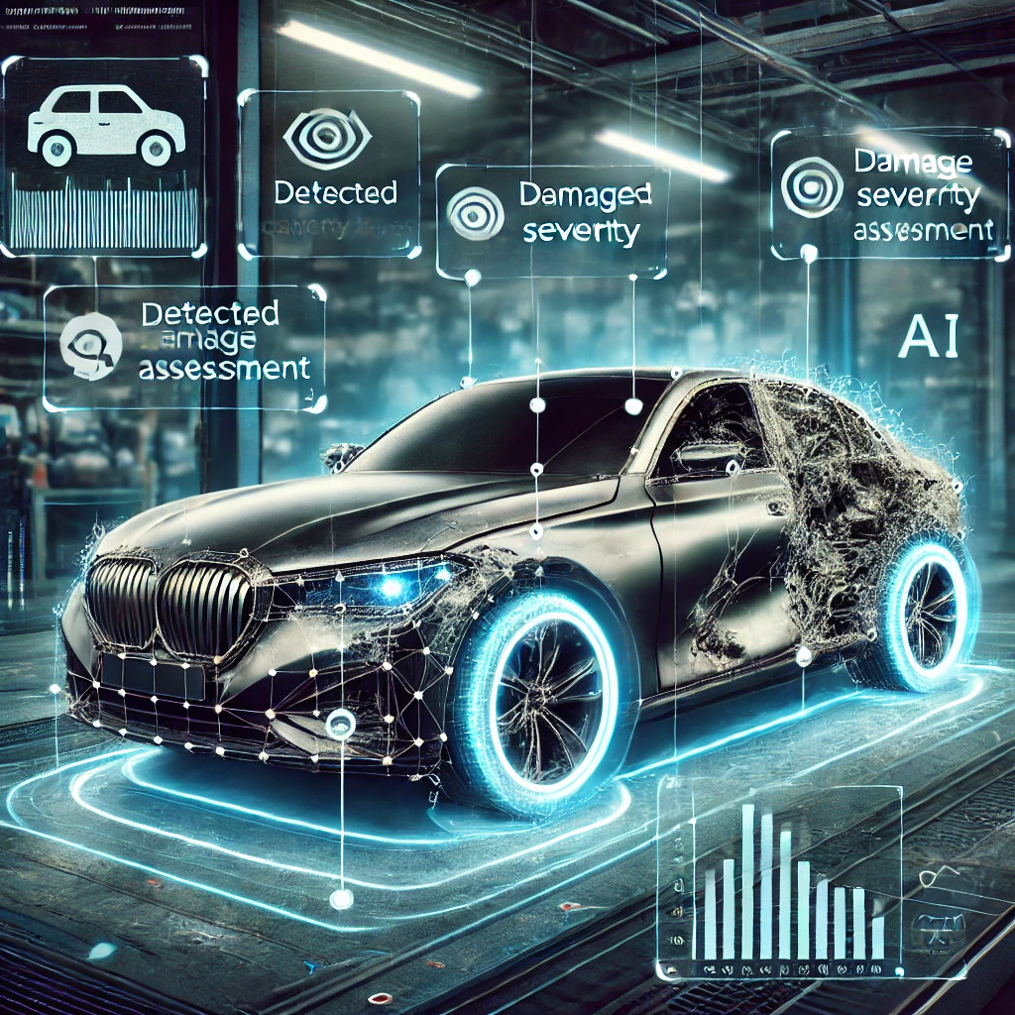

Automated Vehicle Damage Detection and Cost Analysis Using Computer Vision
Bhuvan Kapoor [23MDT1003] Guided By: Dr. Amrit Pal [51665] - SCOPE

Slide 2
Table of Contents
Abstract
Research Objectives
Review of Literature
Datasets
Methodology
Results
Conclusion

Slide 3
Abstract
This research introduces an advanced system for automated vehicle damage assessment leveraging computer vision and deep learning technologies. The proposed solution addresses the challenges of manual vehicle inspection by implementing a three-stage approach: damaged part detection, precise damage segmentation, and cost estimation. The system employs YOLOv11 models for initial damage detection and localization through bounding boxes, followed by detailed damage segmentation at the pixel level. These models work in conjunction to identify various types of vehicle damage including dents, scratches, and structural deformations. In the final stage the cost of repair is evaluated based on the damage type and damaged part detected. The system's performance was evaluated on a diverse dataset of vehicle damage images, demonstrating high detection accuracy and reliable cost estimations comparable to expert assessments. This automated approach significantly reduces the time and subjectivity associated with traditional damage assessment methods, making it particularly valuable for insurance companies, automotive service center, and vehicle inspection facilities. The research contributes to the growing field of automated vehicle inspection systems and presents a practical solution for streamlining damage assessment processes.

Slide 4
Research Objectives
To design and implement a computer vision-based system that accurately detects and segments vehicle damage using YOLOv11 models trained on the CarDD Dataset, enabling precise classification of damage types and affected car parts.
To develop an automated cost estimation framework that maps detected damage types and affected parts to a structured CSV database, retrieving corresponding repair costs and generating a comprehensive cost breakdown for users.
To assess the effectiveness and practicality of the system by evaluating its accuracy, efficiency, and reliability in real-world scenarios, comparing its performance with expert manual assessments to validate its applicability in insurance claims, automotive repair, and vehicle inspection processes.

Slide 5
Review of Literature
Kyu et al. (2020) utilized VGG16 and VGG19 for car damage classification, with VGG19 achieving higher accuracy but facing dataset limitations and overfitting issues.
Zhang et al. (2020) improved Mask R-CNN with enhanced feature extraction for vehicle damage segmentation, addressing challenges in detecting less obvious damages.
Reddy et al. (2022) presented a Mask R-CNN framework for real-time car damage detection and severity estimation.
Mohammed et al. (2023) proposed a Mask R-CNN framework for car damage classification and cost estimation, achieving high accuracy but facing limitations in detecting minor damages.
Suma et al. (2024) leveraged MobileNetV2 for repair cost estimation, offering a cost-effective alternative with potential for real-time assessments.

Slide 6
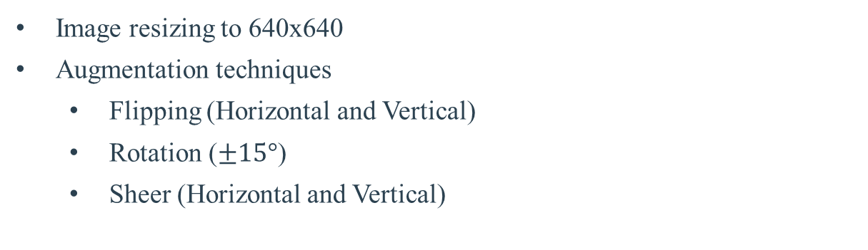
Datasets
1
CarDD Dataset
It contains 4,000 high-resolution car damage images with over 9,000 well annotated instances of six damage categories (scratch, dent, cracks, glass shatter, lamp broken, tire flat).
Preprocessing
Image resizing to 640x640
Augmentation techniques
Flipping (Horizontal and Vertical)
Rotation ($±15°$)
Sheer (Horizontal and Vertical)
* Total images after preprocessing: 6800

Slide 7
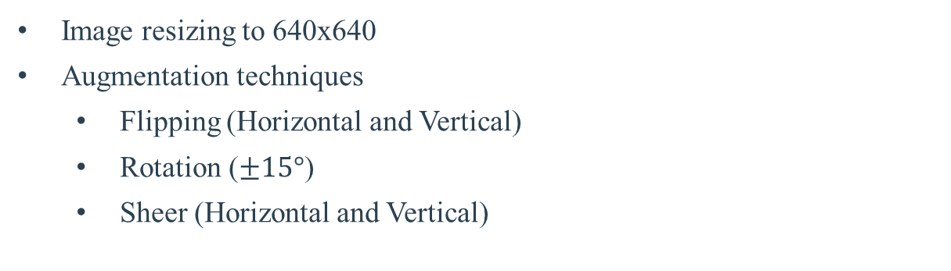
Datasets
2
Car Part Damage Dataset
It contains 3,226 high-resolution car damage images with over 9,000 well annotated instances of seven damaged part categories (Bonnet, bumper, boot, door, fender, light, windshield).
Preprocessing
Image resizing to 640x640
Augmentation techniques
Flipping (Horizontal and Vertical)
Rotation ($±15°$)
Sheer (Horizontal and Vertical)
* Total images after preprocessing: 5493

Slide 8
Datasets
3
Car Part Price Dataset
It is a csv file which contains data for estimating car repair costs based on detected damage and car parts.
CSV File Structure
Car Brand: The manufacturer of the vehicle (e.g., Toyota, Honda, Ford).
Car Model: The specific model of the car (e.g., Corolla, Civic, Mustang).
Car Part: The part of the car that might be damaged (e.g., bumper, fender, door).
Damage Type: The type of damage detected (e.g., scratch, dent, crack).
Part Price: The cost of replacing or repairing the specific car part.

Slide 9
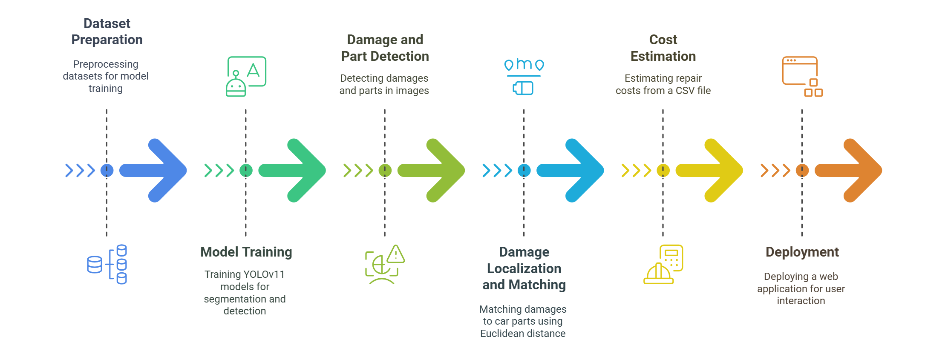
Methodology

Slide 10
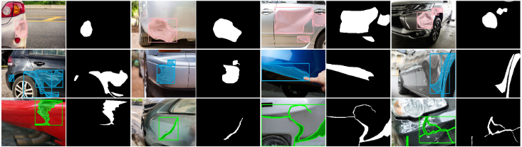
Results YOLOv11 Segmentation Model

Slide 11
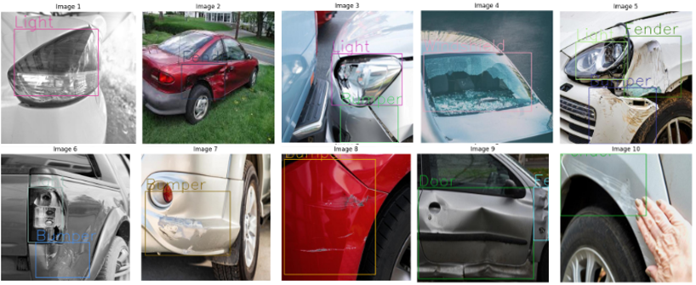
Results YOLOv11 Detection Model

Slide 12
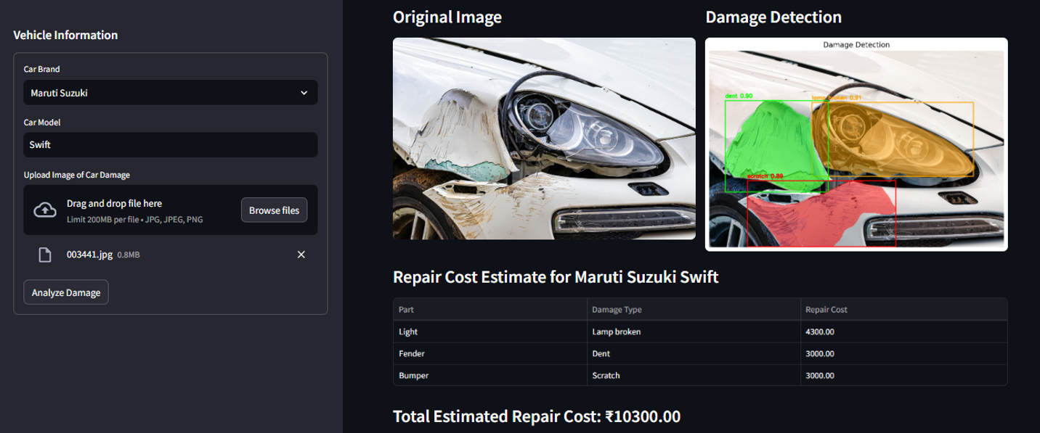
Results Streamlit Deployment Output

Slide 13
Conclusion
Automated and Efficient Damage Assessment: The proposed system successfully automates vehicle damage assessment using computer vision and deep learning, reducing the need for manual inspection. By leveraging YOLOv11 segmentation and detection models, the system accurately identifies damage types and affected car parts.
Cost Estimation: The integration of damage-part matching using Euclidean distance enables precise association between detected damage and car components. The repair cost estimation mechanism, based on a predefined cost database (CSV file), provides reliable and consistent cost assessments.

Slide 14
References
Kyu, P. M. and Woraratpanya, K. (2020). Car damage detection and classification. In Proceedings of the 11th international conference on advances in information tech-nology, pages 1–6.
Mohammed, N. A., Potrus, M. Y., and Ali, A. M. (2023). Deep learning based car dam-age classification and cost estimation. Zanco Journal of Pure and Applied Sciences,35(1):1–9.
Zhang, Q., Chang, X., and Bian, S. B. (2020a). Vehicle-damage-detection segmentation algorithm based on improved mask rcnn. IEEE Access, 8:6997–7004.
Reddy, D. A., Shambharkar, S., Jyothsna, K., Kumar, V. M., Bhoyar, C. N., and Somkunwar, R. K. (2022). Automatic vehicle damage detection classification frame-work using fast and mask deep learning. In 2022 Second International Conference on Computer Science, Engineering and Applications (ICCSEA), pages 1–6. IEEE.
Pérez-Zarate, S. A., Corzo-García, D., Pro-Martín, J. L., Álvarez-García, J. A.,Martínez-del Amor, M. A., and Fernández-Cabrera, D. (2024). Automated car dam-age assessment using computer vision: Insurance company use case. Applied Sciences, 14(20):9560.
Wang, X., Li, W., and Wu, Z. (2023). Cardd: A new dataset for vision-based car damage detection. IEEE Transactions on Intelligent Transportation Systems, 24(7):7202–7214.
https://app.roboflow.com/projects-f6ur0/car-damage-detection-t0g92-5ueaa/3

Slide 15

Thank You

